Slide 1
A Healthy Look at
Real Estate Demand
Amy Henley, Susi Ng, Rosina Dodd

Slide 2
Our Investigation
How do health factors correlate to real estate demand?
Hypothesis: Higher demand may indicate a higher economic class and therefore a lifestyle which includes better access to healthcare and lower rates of lifestyle-related risks and conditions, such as smoking and obesity.
Tools: Matplotlib, Pandas, Google Maps API, Jupyter Notebook
Notes:
Amy

Slide 3
Our Samples
Counties with the highest and lowest sale-to-list ratios, from 2014 - 2018, available on Zillow.
Sale-to-List price is an indicator of a variety of factors, but generally over-simplified as regional demand.
Healthcare data is an economic indicator.
Data Sources Real Estate: Zillow Health data: The County Health Rankings & Roadmaps program
Notes:
Amy

Slide 4
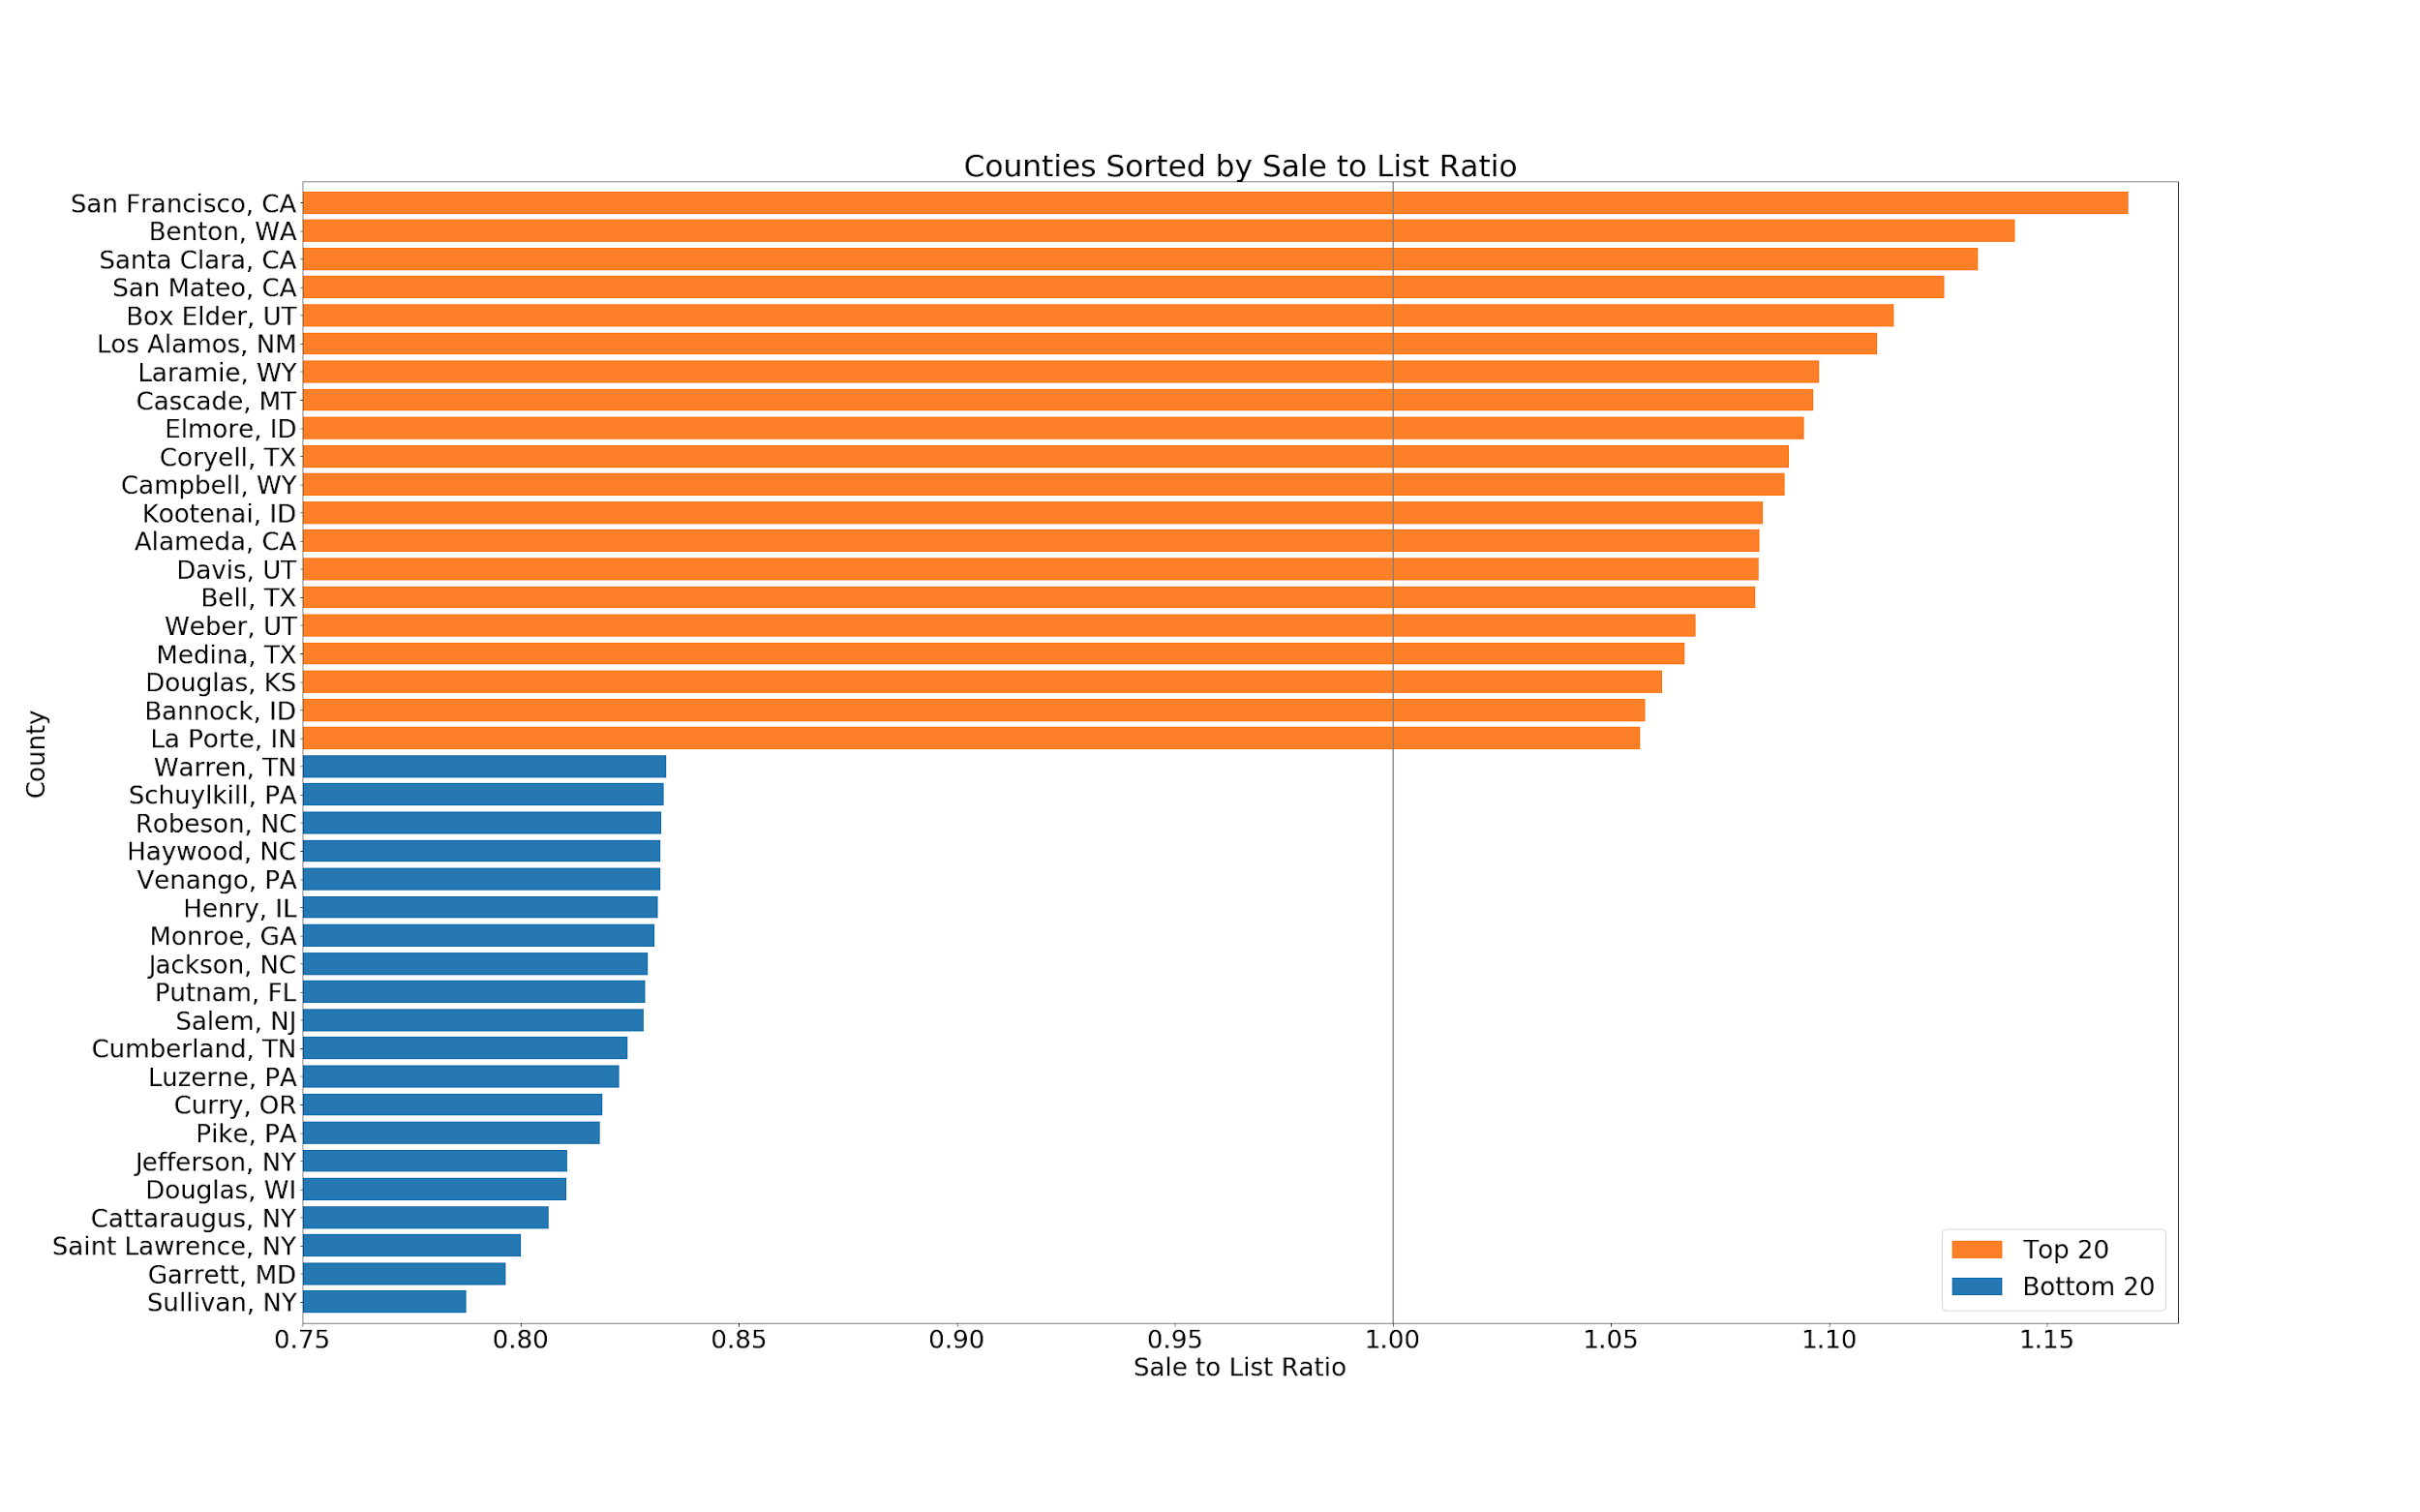
The Counties
Bottom 20 Counties | Sale to List Ratio
Warren, TN | 0.833
Schuylkill, PA | 0.833
Robeson, NC | 0.832
Haywood, NC | 0.832
Venango, PA | 0.832
Henry, IL | 0.832
Monroe, GA | 0.831
Jackson, NC | 0.829
Putnam, FL | 0.829
Salem, NJ | 0.828
Cumberland, TN | 0.825
Luzerne, PA | 0.823
Curry, OR | 0.819
Pike, PA | 0.818
Jefferson, NY | 0.811
Douglas, WI | 0.81
Cattaraugus, NY | 0.806
Saint Lawrence, NY | 0.8
Garrett, MD | 0.797
Sullivan, NY | 0.788
Top 20 Counties | Sale to List Ratio
San Francisco, CA | 1.169
Benton, WA | 1.143
Santa Clara, CA | 1.134
San Mateo, CA | 1.126
Box Elder, UT | 1.115
Los Alamos, NM | 1.111
Laramie, WY | 1.098
Cascade, MT | 1.096
Elmore, ID | 1.094
Coryell, TX | 1.091
Campbell, WY | 1.09
Kootenai, ID | 1.085
Alameda, CA | 1.084
Davis, UT | 1.084
Bell, TX | 1.083
Weber, UT | 1.069
Medina, TX | 1.067
Douglas, KS | 1.062
Bannock, ID | 1.058
La Porte, IN | 1.057
Notes:
Amy

Slide 5
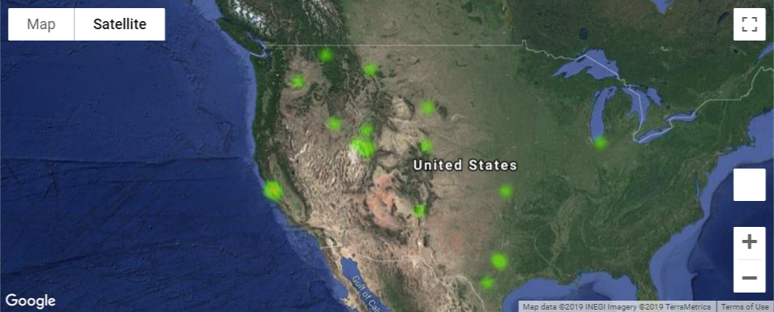
Top 20 counties
Notes:
Amy

Slide 6
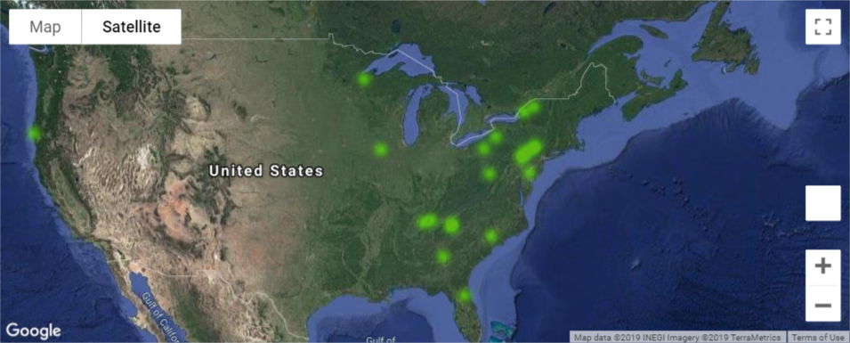
Bottom 20 counties
Map of the least competitive counties
Notes:
Amy

Slide 7
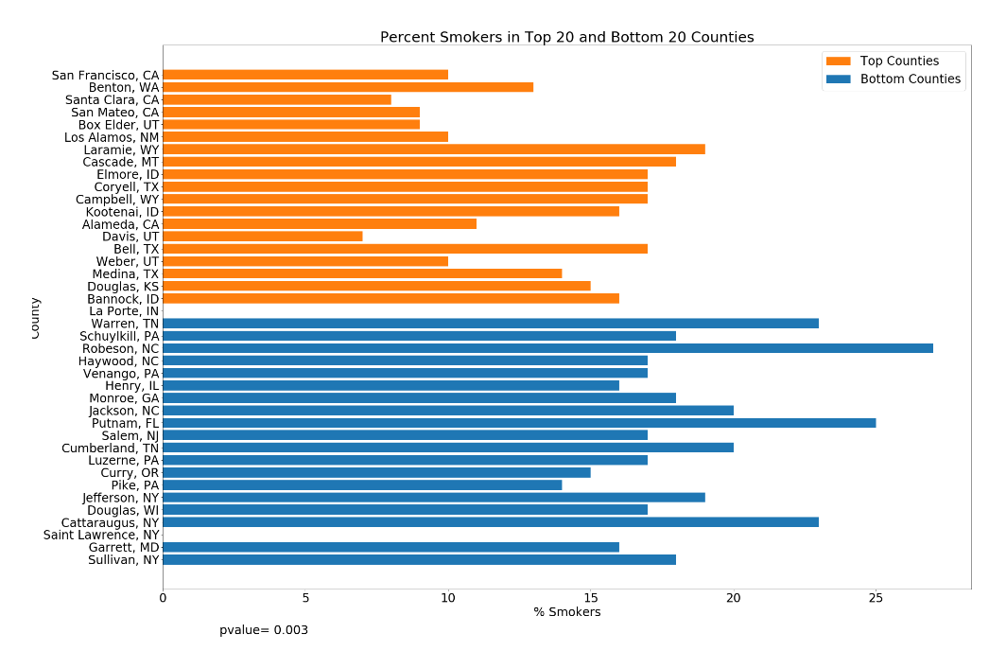
% Smokers
Notes:
Susi

Slide 8
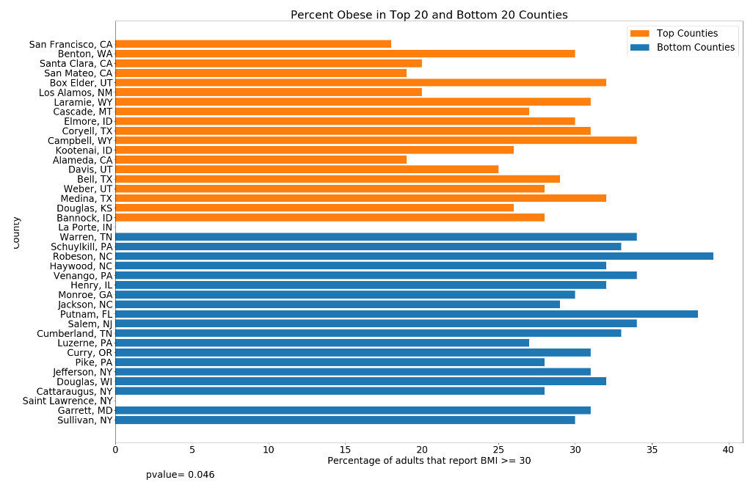
Obesity
Notes:
Susi

Slide 9
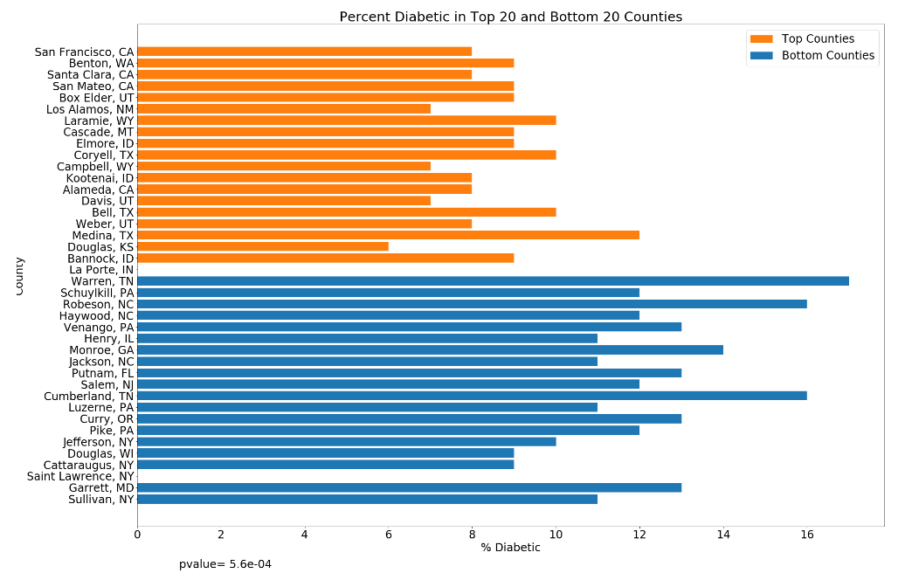
Diabetes
Notes:
Susi

Slide 10
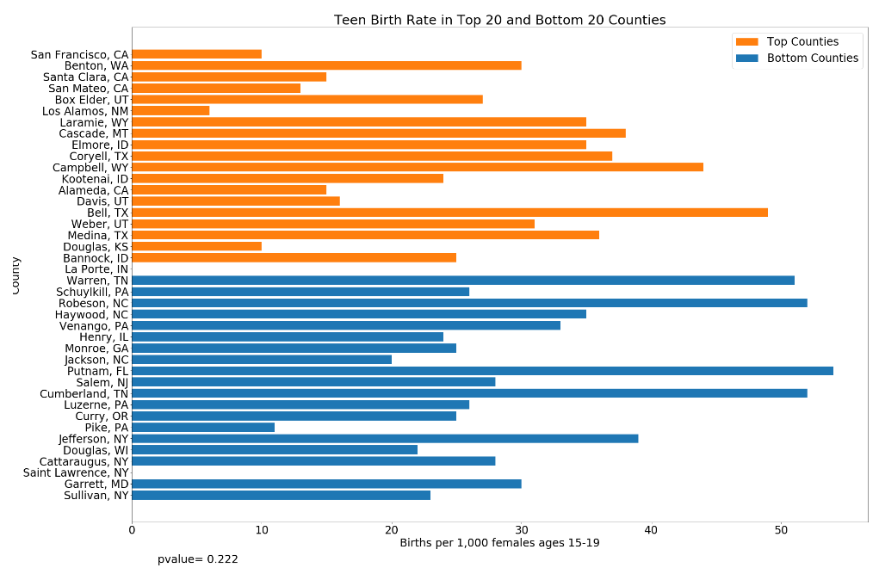
Teen Birth Rate
p-value
0.222
Notes:
Susi

Slide 11
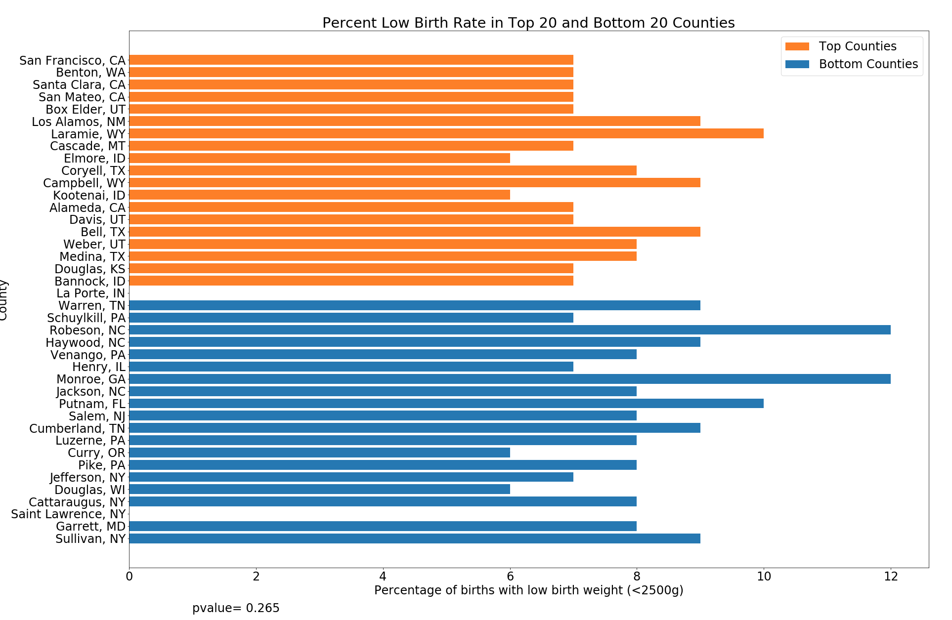
Low Birth Weight
p-value
0.265
Notes:
Susi

Slide 12
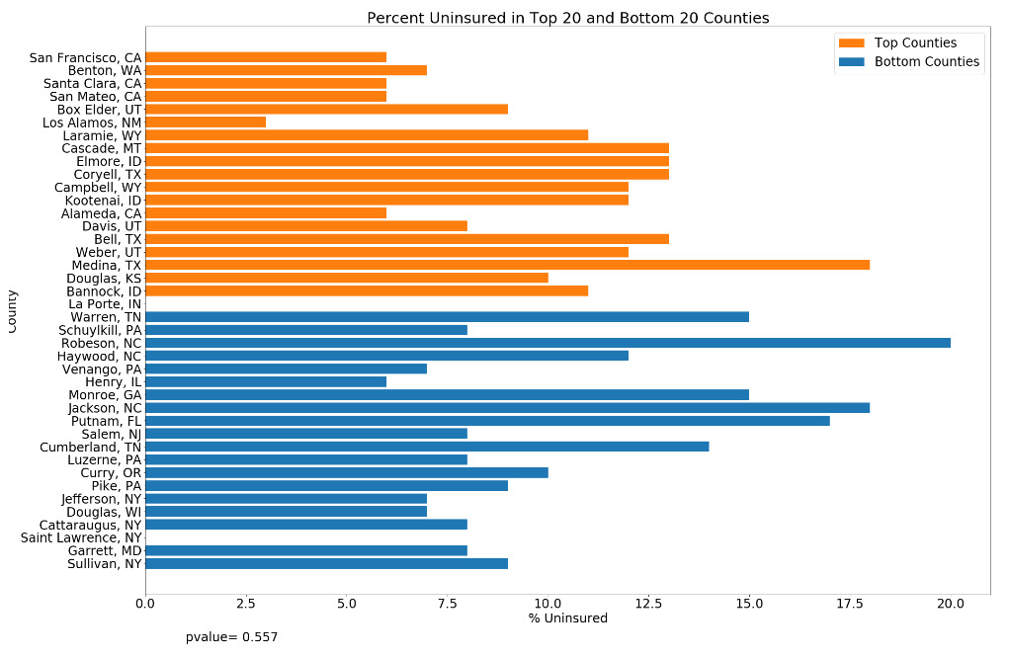
% Uninsured
p-value
0.557
Notes:
Rosina

Slide 13
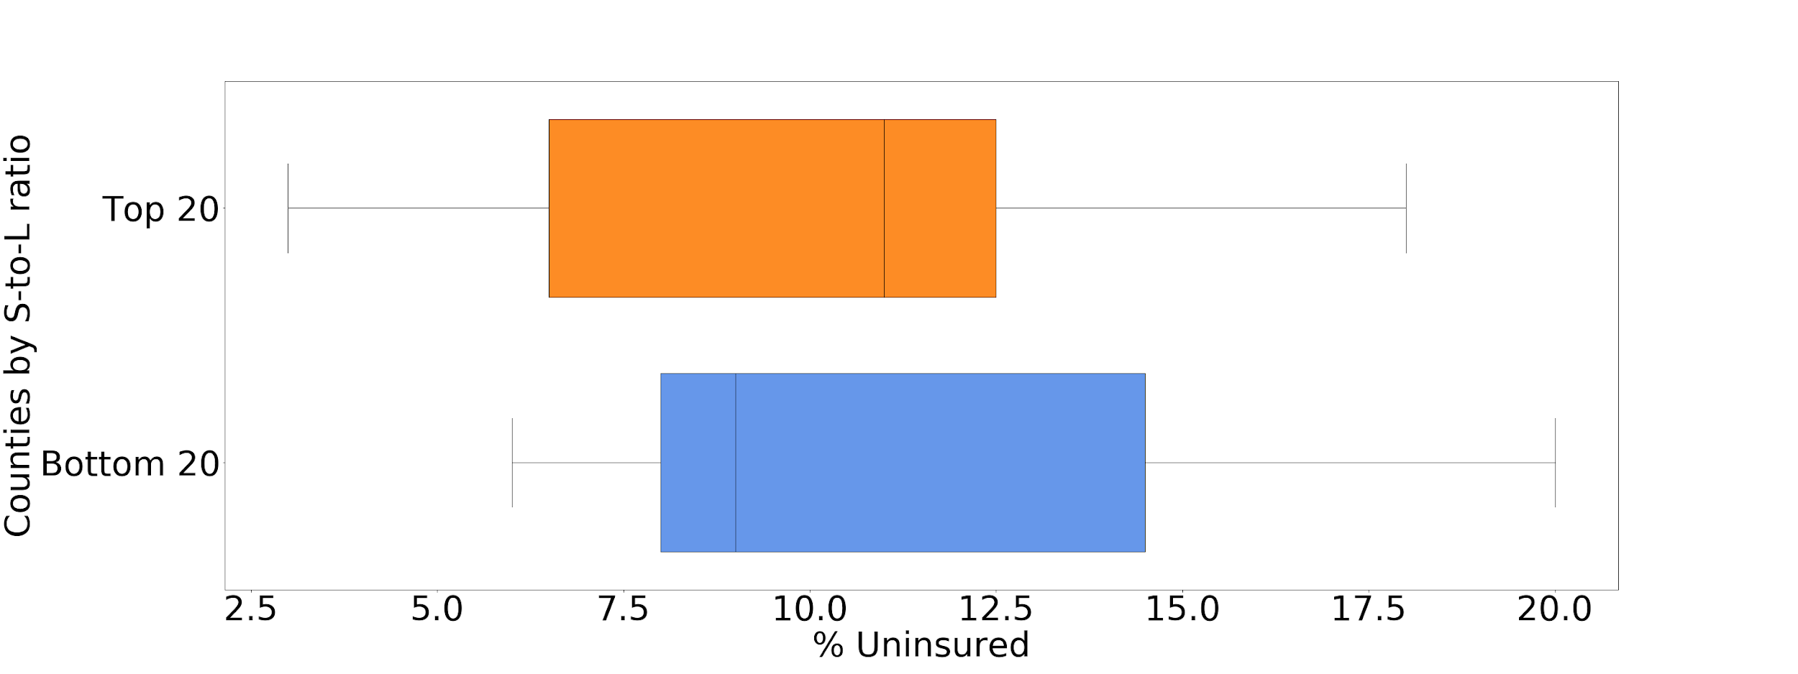
% Uninsured
p-value
0.557
Notes:
Rosina

Slide 14
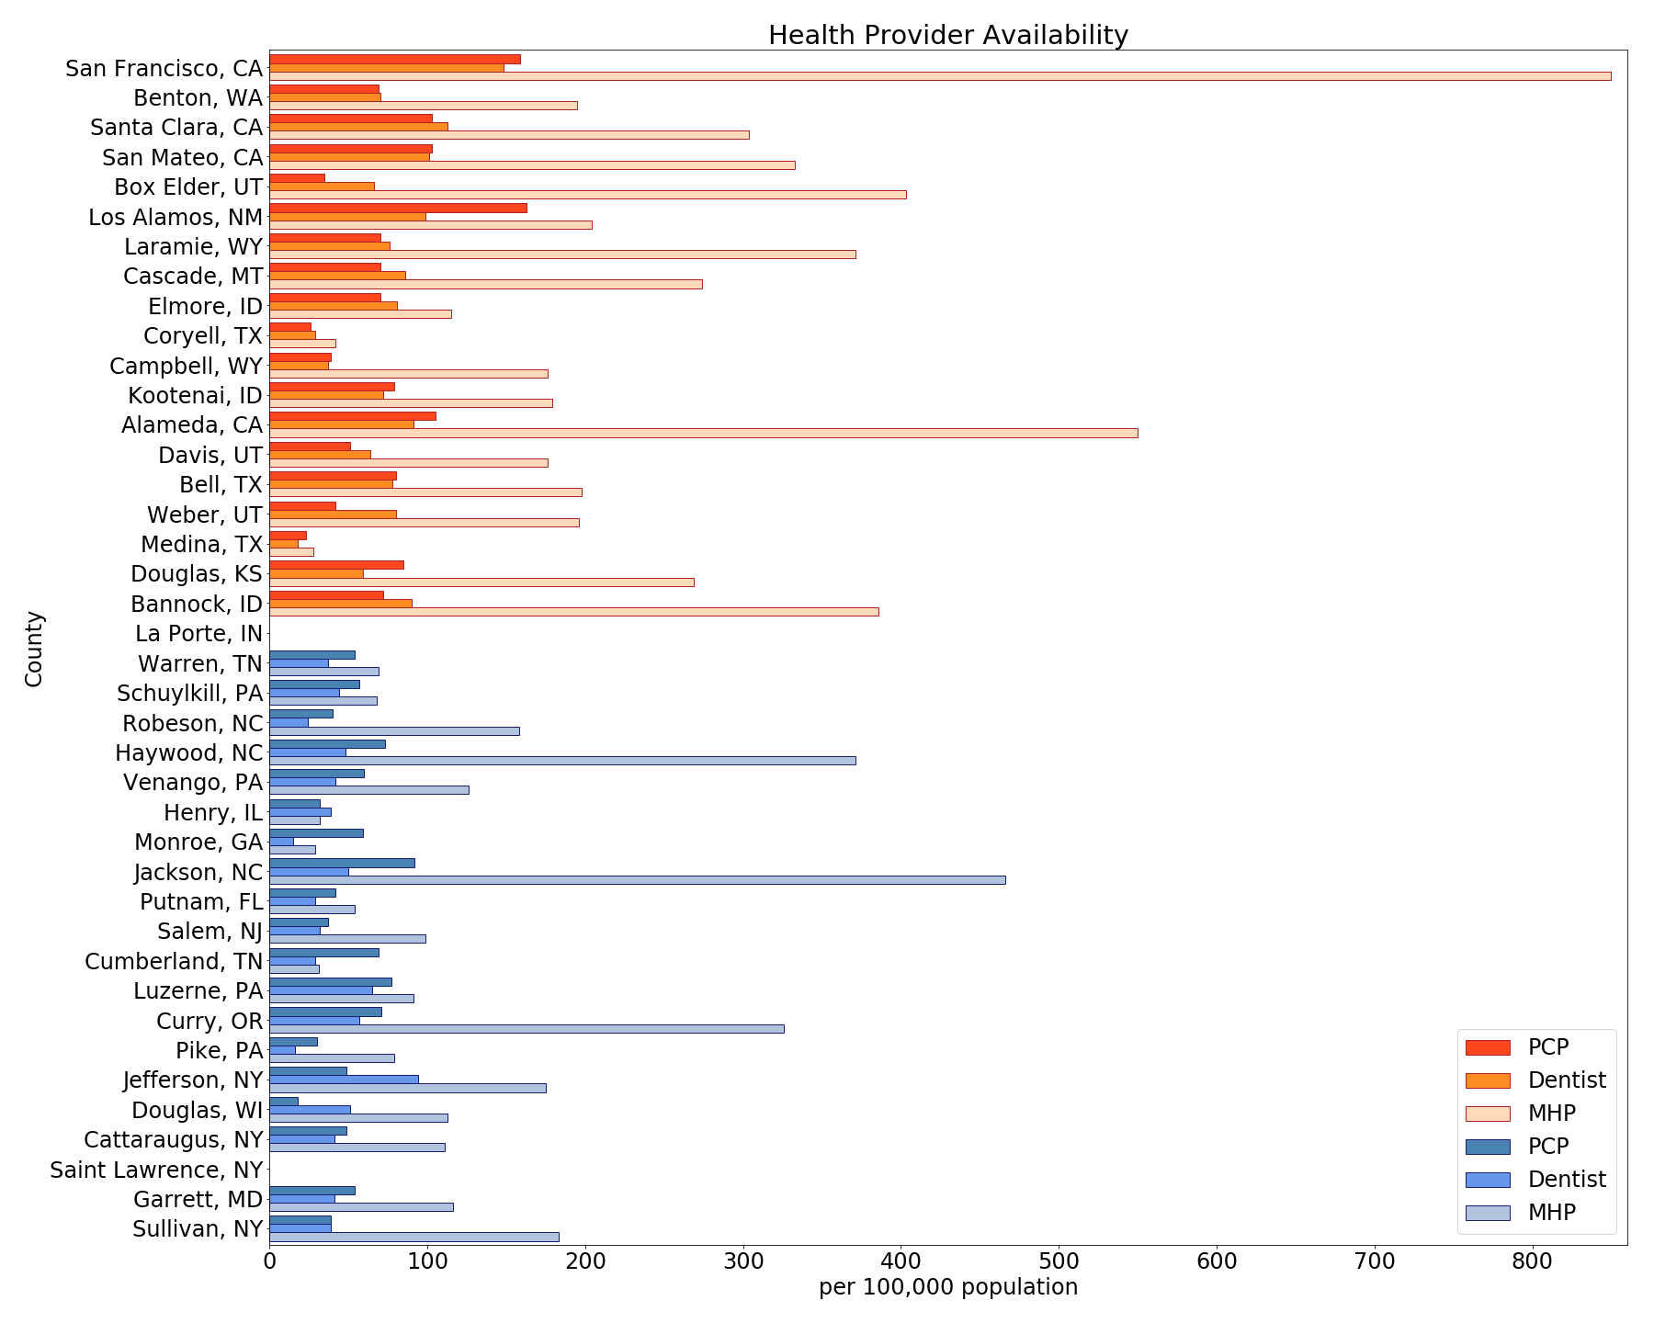
Health
Provider
Availability
Notes:
Rosina

Slide 15
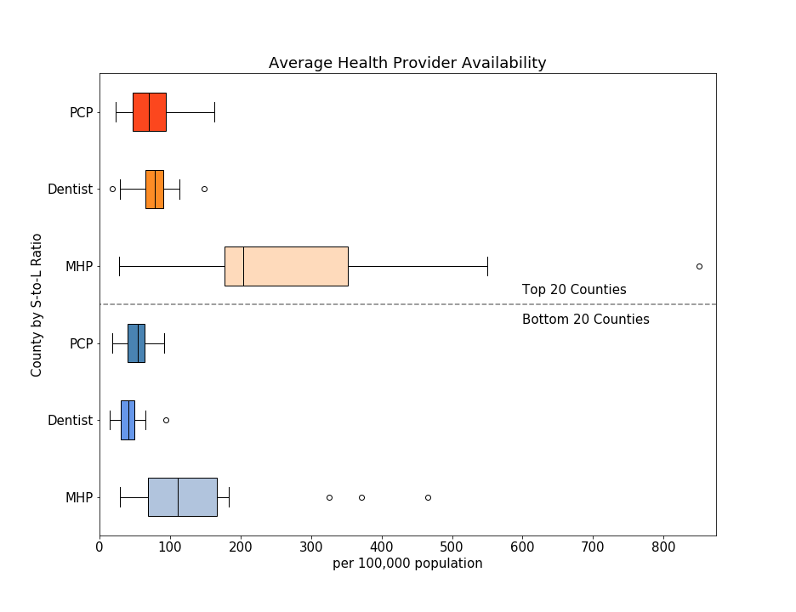
Health Provider
Availability
Notes:
Rosina

Slide 16
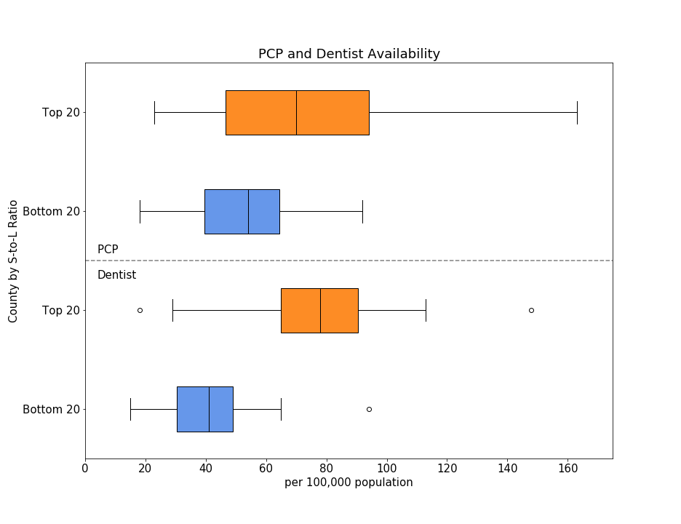
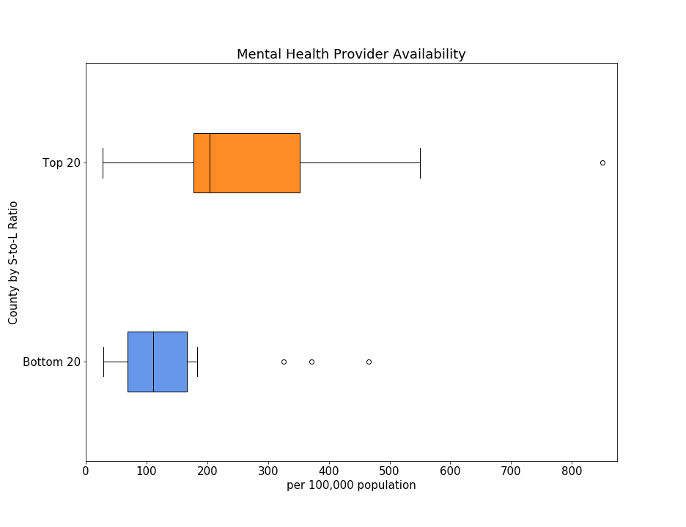
Health Provider Availability
PCP Rate
p-value
0.043
MHP Rate p-value
0.018
Dentist Rate
p-value
6.3e-4
Notes:
Rosina

Slide 17
Conclusions and New Questions
While median sale price and price per sq ft are obvious market indicators of economic class, sale-to-list ratio has a broader range of factors. A high- or low- demand county does not align perfectly with “wealthy” or “poor”.
In regions where people are willing to pay more than asking, there are more healthcare providers but the same % of the population is uninsured. Are these people also willing to pay more for healthcare?
If real estate aligns with education, might the local housing market correlate with teen pregnancy rate? What’s going on with prenatal care?

Slide 18
Challenges
Finding questions and data
Data munging Trailing spaces that don’t show up in a csv file
Basic plot aesthetics
Git

Slide 19
Thanks!
Any questions?

